Slide 1
5th Grade Materials
Mr. B

Slide 3
Please Watch This Video
This video helps explain the difference between a food chain and a food web.
Food chains and food webs are both systems
Please watch it as many times as you need as it will help you in the activities.
https://www.youtube.com/watch?v=FFloV2J-eKI

Slide 4
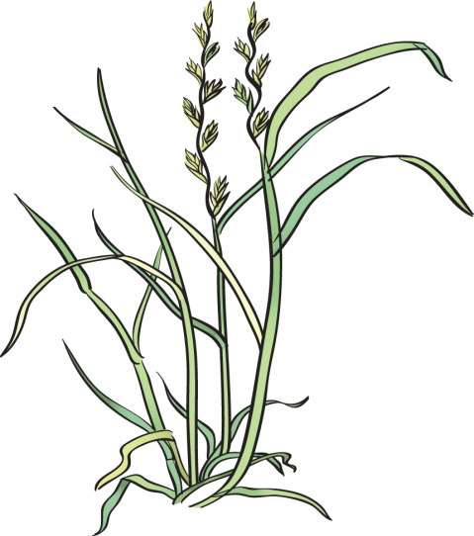
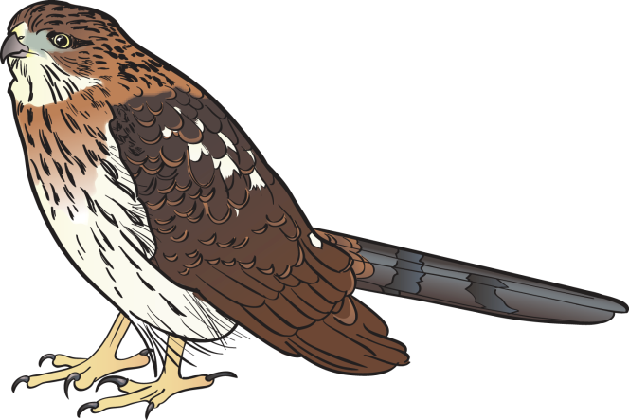
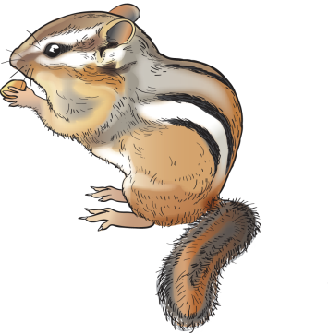
Food Chains
Grama Grass
Chipmunk
Hawk
The path that food takes from one organism to another organism is called a food chain. The direction the arrows point show the direction that food (matter and energy) moves through a food chain.

Slide 6
Example Food Chain

Slide 7
Lets Build a Food Chain
Record your food chain on a piece of paper.
Use arrows to show how the energy moves from organisms that are eaten to organisms that eat them.
Label the organisms as producers or consumers.
Write a few sentences to describe how the Sun's energy is used by producers and is transferred through a food chain.

Slide 8
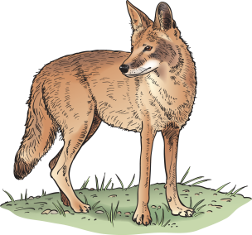
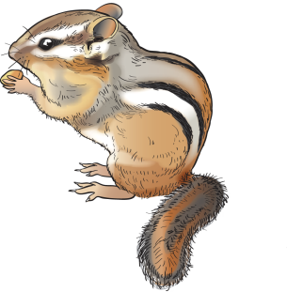
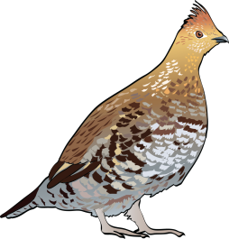
Food Webs
A model that shows all the feeding relationships in an ecosystem is called a food web.

Slide 9
Example Food Web

Slide 10
Food webs Your turn!
Draw your food webs on a piece of paper.
How do the predators and prey interact?
What would happen if the decomposers were removed from the system?
Why is it important for energy to flow through the ecosystem?

